Slide 1

CENSUS PROJECT
STUDENT ID: 202403820 SAMUEL DATUBO JAJA

Slide 2
Agenda
Objectives
Data Cleaning Process
Features Cleaning
Key Findings & Further Analysis

Slide 3
Objectives
Cleaning Census data using programming techniques.
1
Analyzing Census data using statistical analysis and hypothesis testing.
2
Making informed decisions on land development and investment based on the analysis of census data.
3

Slide 4
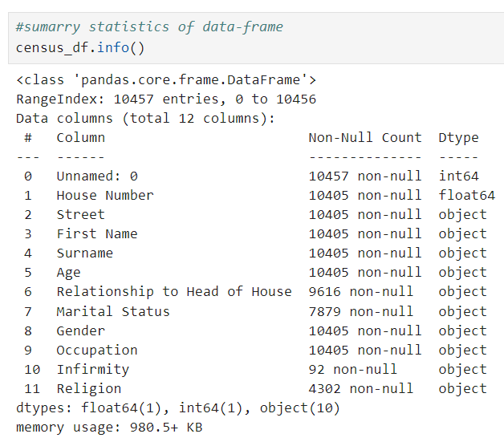
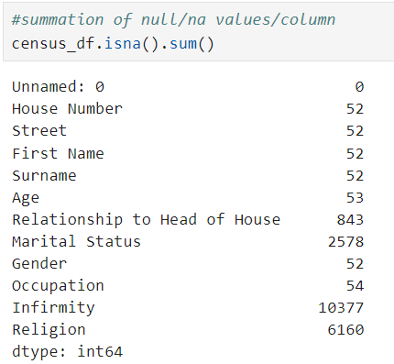
Data Cleaning Process: Census Data-Frame Summary & Null Values

Slide 5
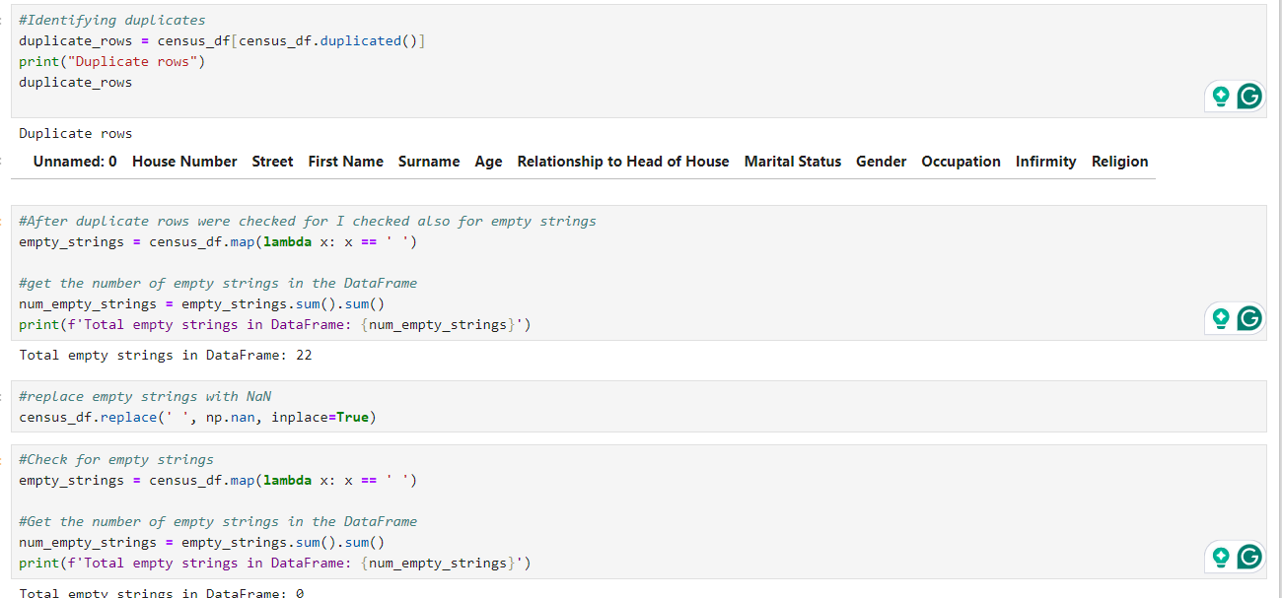
Data Cleaning Process: Handling duplicate and empty strings in Census Data-Frame

Slide 6
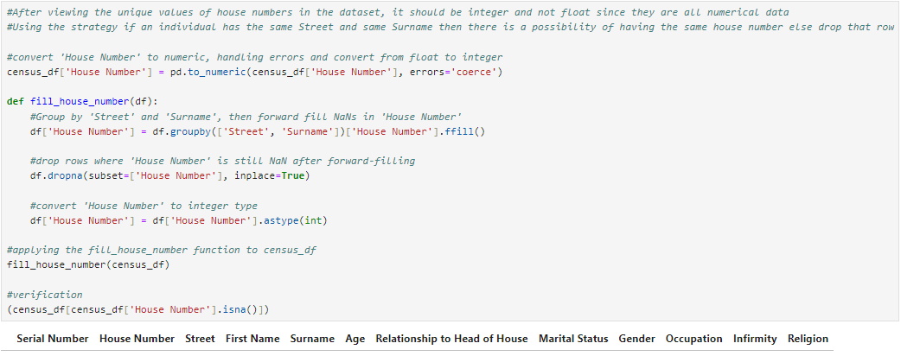
Features/Columns Cleaning: “House Number”

Slide 7
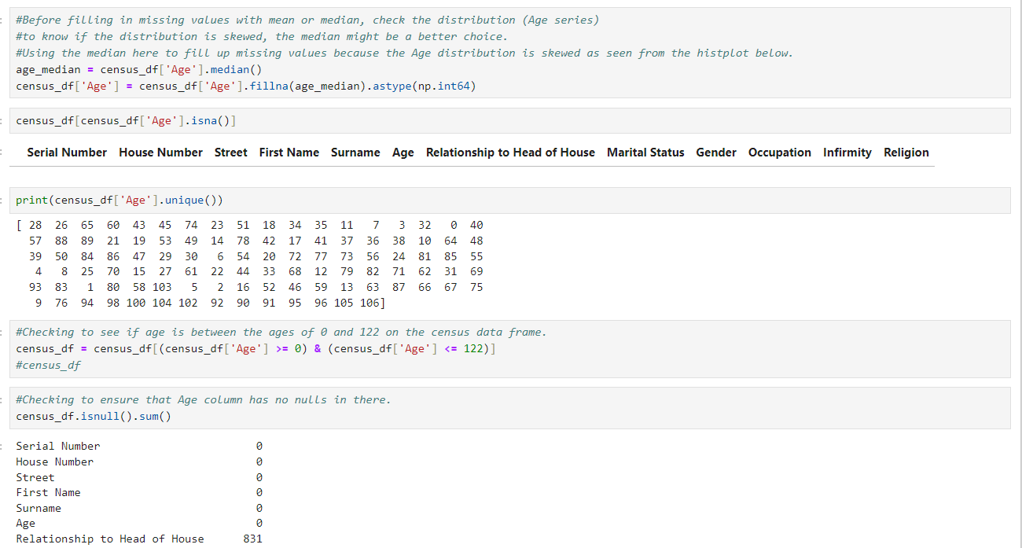
Features/Columns Cleaning: “Age”

Slide 8
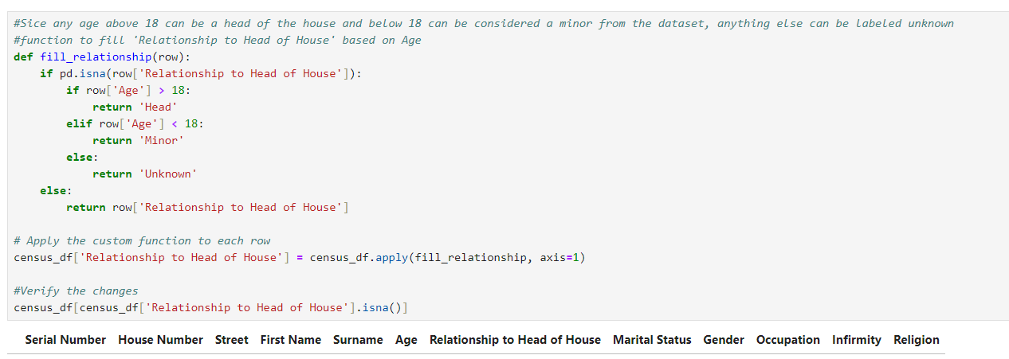
Features/Columns Cleaning: “Relationship to Head of House”

Slide 9
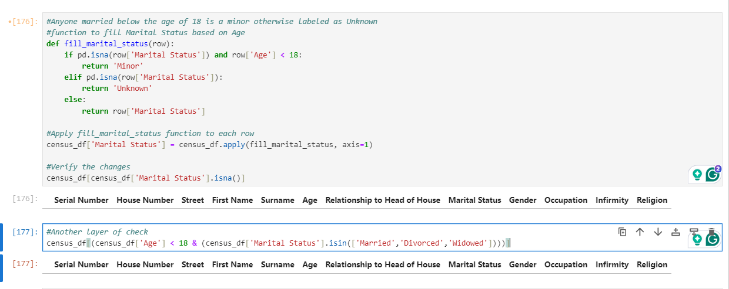
Features/Columns Cleaning: “Marital Status”

Slide 10
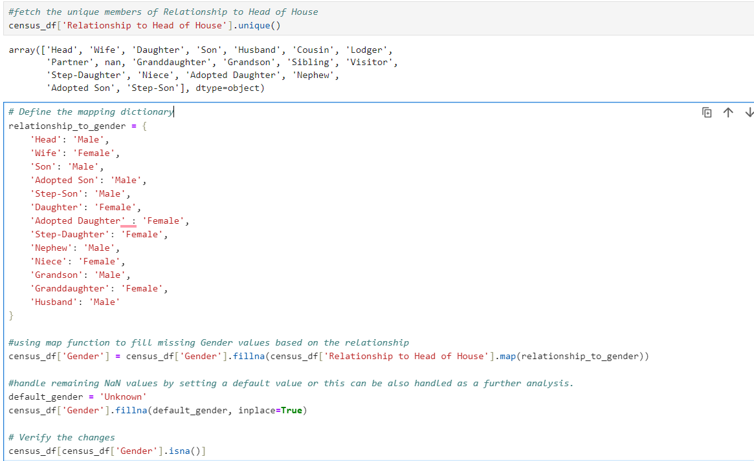
Features/Columns Cleaning: “Gender”

Slide 11
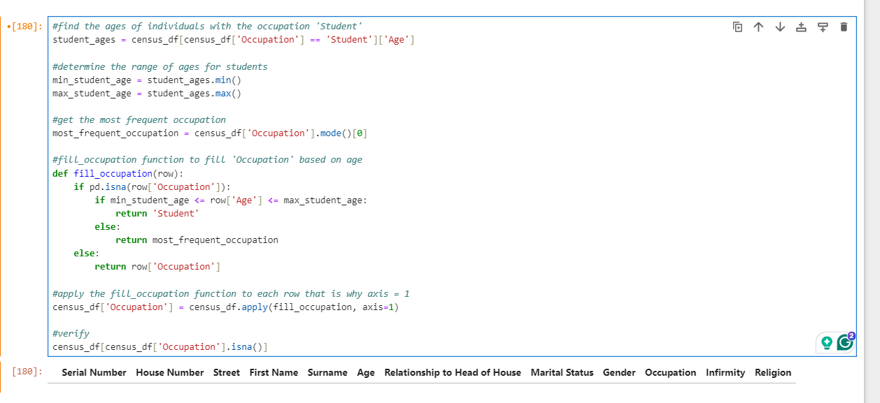
Features/Columns Cleaning: “Occupation”

Slide 12
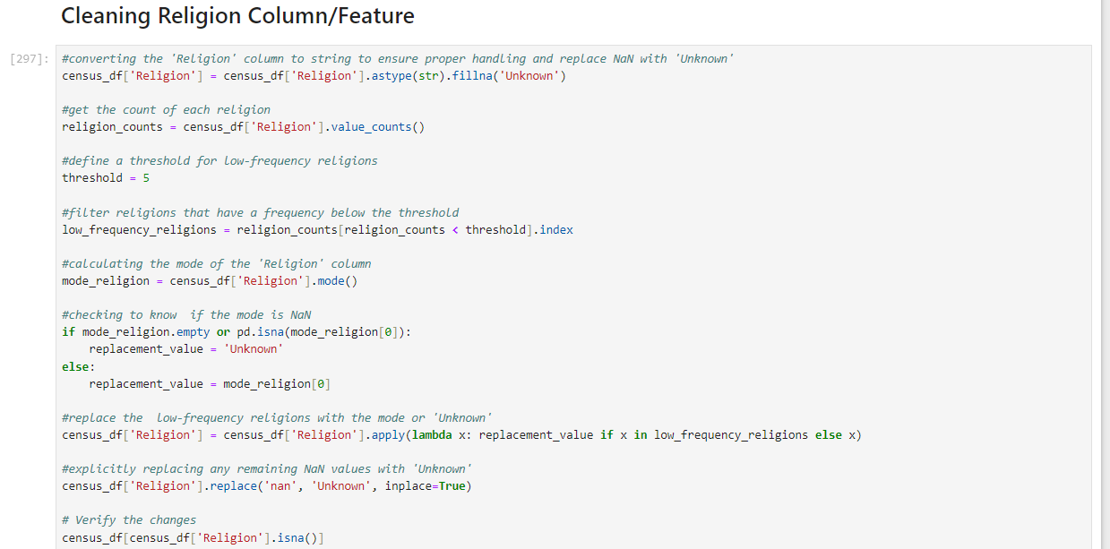
Features/Columns Cleaning: “Religion”

Slide 13
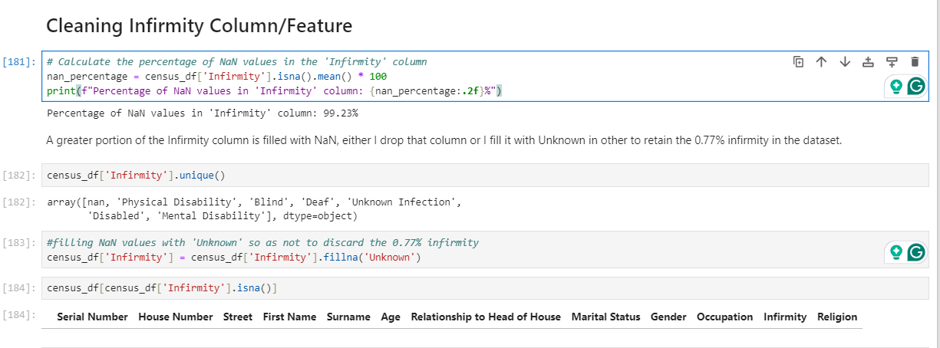
Features/Columns Cleaning: “Infirmity”

Slide 14
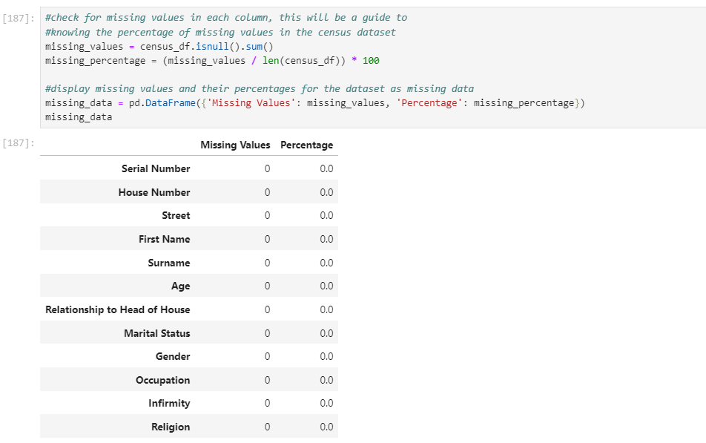
Features/Columns Cleaning: Percentage Computation

Slide 15
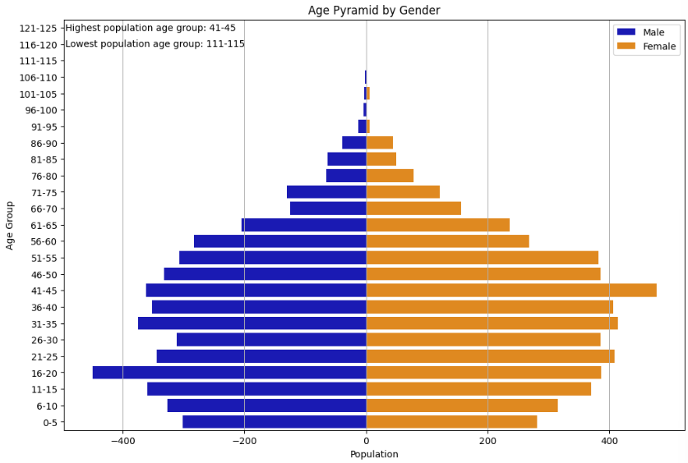
Early Insights
Highest Population age group is 41-45 and 16-20 is the second Highest Population age group.
The lowest population age group is 111-115.
If there is an increase in the age group of 16-45 then high-density housing should be built.
Emergency medical building should be built if there is any evidence of increase in female between 0-45 age-group for future pregnancies.
Insight from the census pyramid shows that If there is evidence of increase from 0-20 age-group in the population, then funding should be channeled to building schools.
Increase in Infrastructure development

Slide 16
Further Analysis
Birth Rate
Death Rate
Does the population grow or shrink?
Demand for more housing ?
Using these to answer the key questions of the census project which gives data driven decisions/solutions.

Slide 17
Thank You

